Slide 1
Flying and Judging F3A
SCHEMATIC MANOEUVRE ILLUSTRATIONS
SCHEDULE F-25

Slide 2
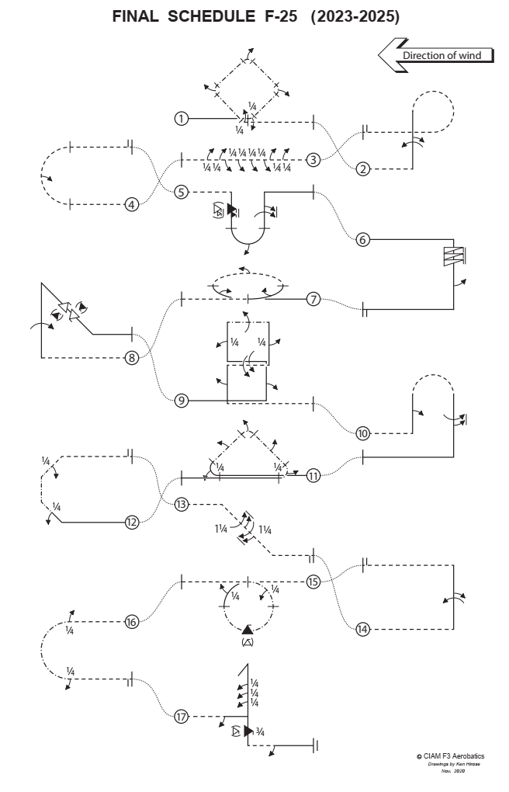
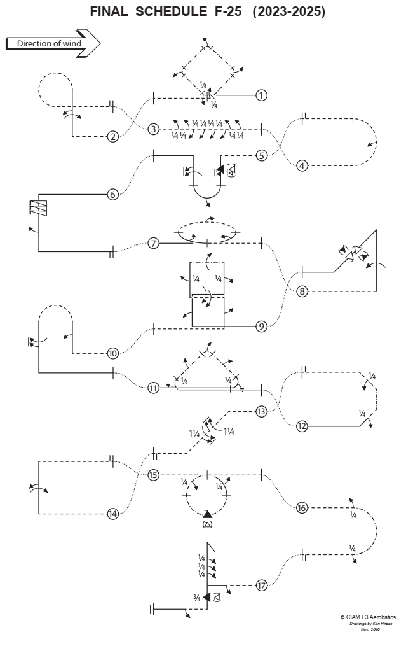

Slide 3
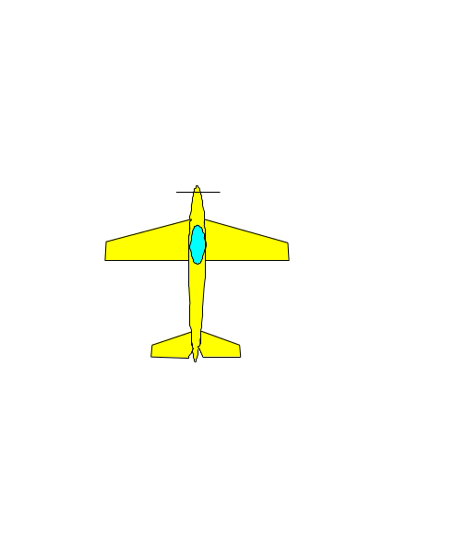
Explanations:
Aircraft upright
Aircraft inverted
Aircraft in Knife-Edge View from Top
Aircraft in Knife-Edge View from Below
part roll
half roll
roll
¼
pos. spin
neg. spin
snap rolls
pos.
neg.
reference points

Slide 4

Take-off procedure
( not judged, not scored )
wind
120⁰
Safety line

Slide 5
F-25.01 Square loop on Corner with quarter roll integrated, half roll integrated, half roll integrated, half roll integrated, quarter roll integrated
½ roll integrated
½ roll integrated
½ roll integrated
¼ roll
integrated
¼ roll integrated
From upright, pull through a one eighth loop with quarter roll integrated into a forty-five degree knife-edge upline, perform a quarter knife-edge loop with half roll integrated into a forty five degree knife-edge upline, perform a quarter knife-edge loop with half roll integrated into a forty five degree knife-edge downline, perform a quarter knife-edge loop with half roll integrated into a forty five degree knife-edge downline, perform a one eighth knife-edge loop with quarter roll integrated, exit inverted.
F-25.01.01

Slide 6
F-25.01 Square loop on Corner with quarter roll integrated, half roll integrated, half roll integrated, half roll integrated, quarter roll integrated
½ roll integrated
During Knife Edge the wing must be in the vertical plane.
Part rolls integrated on circular flightpath of the part loops.
½ roll integrated
½ roll integrated
¼ roll
integrated
45°
All radii are equal.
¼ roll integrated
F-25.01.02

Slide 7
F-25.02 Figure Nine with roll, half roll in opposite directions
½ roll
roll
From inverted, push through a quarter loop into a vertical upline, perform consecutively a roll and a half roll in opposite directions, push through a three quarter loop, exit inverted.
F-25.02.01

Slide 8
F-25.02 Figure Nine with roll, half roll in opposite directions
Roll and ½ roll centered on middle of the line.
Between rolls and part rolls in opposite directions there must be no line.
All radii are equal.
F-25.02.02

Slide 9
F-25.03 Roll Combination with consecutive two quarter rolls, four consecutive quarter rolls in opposite direction, two consecutive quarter rolls in opposite direction
¼
¼
¼
¼
¼
¼
¼
¼
From inverted, perform consecutively two consecutive quarter rolls, four consecutive quarter rolls in opposite
direction, two consecutive quarter rolls in opposite direction, exit inverted.
F-25.03.01

Slide 10
F-25.03 Roll Combination with consecutive two quarter rolls, four consecutive quarter rolls in opposite direction, two consecutive quarter rolls in opposite direction
Lines between part rolls must be short
and of equal length.
Between part rolls in opposite direction there must be no line.
¼
¼
¼
¼
¼
¼
¼
¼
F-25.03.02

Slide 11
F-25.04 Half Loop with half roll integrated
From inverted, push through a half loop while integrating a half roll, exit inverted..
F-25.04.01

Slide 12
F-25.04 Half Loop with half roll integrated
Roll rate must be constant.
½ roll must be integrated on circular flightpath of the half loop.
F-25.04.02

Slide 13
F-25.05 Pull Pull Push Humpty Bump with one and half snap roll, half roll integrated, one and a half roll.
1 ½ snap roll
( )
1 ½ roll
½ roll integrated
From inverted, before centre pull through a quarter loop into a vertical downline, perform one and a half snap roll, pull through a half loop with half roll integrated into a vertical upline, perform one and a half continuous roll, push through a quarter loop, exit upright.
F-25.05.01

Slide 14
F-25.05 Pull Pull Push Humpty Bump with one and half snap roll, half roll integrated, one and a half roll.
Snap roll and roll on middle of the line.
( )
All radii are equal.
Snap rolls may be positive or negative.
½ roll must be integrated on circular flightpath of the half loop.
If snap roll = barrel roll or aileron roll:
Severe downgrade > 5 pts.
F-25.05.02

Slide 15
F-25.06 Three Turn Spin with half roll
½ roll
From upright, perform a spin with three turns, perform a vertical downline, perform a half roll, pull through a quarter loop, exit upright.
F-25.06.01

Slide 16
F-25.06 Three Turn Spin with half roll
Snap entry - 0 points!
Spiral dive - 0 points!
Forced entry: downgrade.
Line after the spins.
Half roll on middle of the line.
F-25.06.02

Slide 17
F-25.07 Horizontal Circle with three half rolls in opposite direction integrated
½ roll integrated to the outside
½ roll integrated to the inside
½ roll integrated to the inside
½ roll
From upright, perform a horizontal circle with half roll integrated in the first ninety degrees, half roll in opposite direction integrated in next one hundred eighty degrees, half roll in opposite direction integrated in the last ninety degrees, exit inverted.
Note: First half roll is to the inside.
F-25.07.01

Slide 18
F-25.07 Horizontal Circle with three half rolls in opposite direction integrated
Roll reversal must be immediate.
plane in knife-edge
Circle must be of constant radius and must be flown at the same altitude.
Roll rates must be constant.
plane inverted
plane upright
First ½ roll integrated must be inside.
The ½ rolls must be integrated on circular flightpath.
½ roll
F-25.07.02

Slide 19
F-25.08 Shark Fin with roll, two snap rolls in opposite direction
( )
Two snap rolls opposite
( )
roll
From inverted, push trough a quarter loop into a vertical upline, perform a roll, push through a three eighths loop into a forty-five degree downline, perform consecutively two snap rolls in opposite direction, pull through a one eighth loop, exit upright.
F-25.08.01

Slide 20
F-25.08 Shark Fin with roll, two snap rolls in opposite direction
Roll and Snap rolls on middle of the line.
Snap rolls may be positive or negative.
Between snap rolls in opposite direction there must be no line.
( )
( )
If snap roll = barrel roll or aileron roll:
Severe downgrade > 5 pts.
45°
All radii are equal.
F-25.08.02

Slide 21
F-25.09 Square Vertical Eight with half roll, roll, quarter roll, roll, quarter roll, roll, half roll
roll
¼ roll
¼ roll
roll
roll
½ roll
½ roll
From upright, pull through a quarter loop into a vertical upline perform a half roll, push through a quarter loop, perform a roll, pull through a quarter loop into a vertical upline perform a quarter roll, perform a quarter knife edge loop (towards the center), perform a roll, perform a quarter knife-edge loop into a vertical downline, perform a quarter roll, push through a quarter loop, perform a roll, pull through a quarter loop into a vertical downline, perform a half roll, push through a quarter loop, exit inverted.
F-25.09.01

Slide 22
F-25.09 Square Vertical Eight with half roll, roll, quarter roll, roll, quarter roll, roll, half roll
¼
¼
All rolls on middle of the lines.
All radii are equal.
Entry and exit must be at the same altitude.
F-25.09.02

Slide 23
F-25.10 Push Push Pull Humpty Bump with half roll, one and a half roll.
½ roll
1 ½ roll
From inverted, push through quarter loop into a vertical upline, perform a half roll, push through a half loop into a vertical downline, perform one and a half continuous rolls, pull through quarter loop, exit upright.
F-25.10.01

Slide 24
F-25.10 Push Push Pull Humpty Bump with half roll, one and a half roll.
Rolls on middle of the line.
All radii are equal.
F-25.10.02

Slide 25
F-25.11 Knife-Edge Triangle with quarter roll integrated, half roll, half roll integrated, half roll, quarter roll integrated
½ roll integrated
½ roll
½ roll
¼ roll integrated
¼ roll integrated
From upright, fly past center pull through a three eighths loop with quarter roll integrated into a forty-five degree knife-edge upline, perform a half roll, perform a quarter knife-edge loop with a half roll integrated into a forty-five degree knife-edge downline, perform a half roll, perform a three eighths knife-edge loop with a quarter roll integrated, exit upright.
F-25.11.01

Slide 26
F-25.11 Knife-Edge Triangle with quarter roll integrated, half roll, half roll integrated, half roll, quarter roll integrated
½ roll integrated
During Knife Edge the wing must be in the vertical plane.
½ rolls on middle of the line.
½ roll
Part rolls integrated on circular flightpath of the part loops.
All radii are equal.
¼ roll integrated
45°
¼ roll integrated
F-25.11.02

Slide 27
F-25.12 Half Eight Sided Loop with quarter roll, quarter roll
¼ roll
¼ roll
From upright, pull through a one eighth loop into a forty-five degree upline, perform a quarter roll, perform a one eighth knife-edge loop into a vertical upline, perform a one eighth knife-edge loop into a forty-five
degree knife-edge upline, perform a quarter roll, pull through a one eighth loop, exit inverted.
F-25.12.01

Slide 28
F-25.12 Half Eight Sided Loop with quarter roll, quarter roll
¼ rolls on middle of the line.
¼
45° lines and vertical line must be of equal length.
During Knife Edge the wing must be in the vertical plane.
All radii are equal.
¼
F-25.12.02

Slide 29
F-25.13 Forty Five Degree Downline with two consecutive one and a quarter rolls in opposite direction.
1 ¼ roll
1 ¼ roll
From inverted, pull through a one eighth loop into a forty five degree downline, perform consecutively two one and a quarter rolls in opposite direction, push through a one eighth loop, exit inverted.
F-25.13.01

Slide 30
F-25.13 Forty Five Degree Downline with two consecutive one and a quarter rolls in opposite direction.
Rolls centered on middle of the line.
1 ¼
All radii are equal.
Between rolls in opposite direction there must be no line.
1 ¼
45°
F-25.13.02

Slide 31
F-25.14 Half Square Loop with roll, half roll in opposite direction
½ roll
roll
From inverted, push through a quarter loop into a vertical upline, perform consecutively a roll and a half roll in opposite direction, pull through a quarter loop, exit inverted.
F-25.14.01

Slide 32
F-25.14 Half Square Loop with roll, half roll in opposite direction
Rolls centered on middle of the line.
Between rolls and part rolls in opposite direction there must be no line.
All radii are equal.
F-25.14.02

Slide 33
F-25.15 Avalanche (from top) with quarter roll integrated,
snap roll, quarter roll integrated
¼ roll integrated
¼ roll integrated
( )
From inverted, pull through a loop, perform a quarter roll integrated in the first ninety degrees of the loop, perform a snap roll at the bottom of the loop, perform a quarter roll integrated in last ninety degrees of the loop, exit inverted.
F-25.15.01

Slide 34
F-25.15 Avalanche (from top) with quarter roll integrated,
snap roll, quarter roll integrated
¼ roll integrated
¼ roll integrated
Loop must be round.
The ¼ roll must be integrated on circular flightpath of the first 90° of the loop.
The ¼ roll must be integrated on circular flightpath of the last 90° of the loop.
( )
Snap roll may be positive or negative.
If snap roll = barrel roll or aileron roll:
Severe downgrade > 5 pts.
F-25.15.02

Slide 35
F-25.16 Knife.Edge Split S with quarter roll, quarter roll
¼ roll
¼ roll
From inverted, perform a quarter roll, immediately perform a half knife-edge loop down, immediately perform a quarter roll, exit inverted.
F-25.16.01

Slide 36
F-25.16 Knife-Edge Split S with quarter roll, quarter roll
The half knife-edge loop starts immediately after the ¼ roll, the second ¼ roll starts immediately after the half knife-edge loop.
During knife-edge the wing must be in the vertical plane.
¼
F-25.16.02

Slide 37
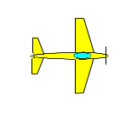
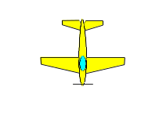
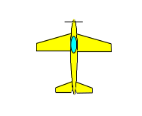
F-25.17 Stall Turn with half roll, three quarter rolls, three quarter snap roll, half roll
¼ roll
¼ roll
( )
¾ snap roll
¼ roll
½ roll
½ roll
From inverted, perform a half roll, pull through a quarter loop into a vertical upline, perform three consecutive quarter rolls, perform a stall turn into a vertical downline, perform a three quarter snap roll, push through a quarter loop, perform a half roll, exit upright.
Note: Exit starts after the last half roll.
F-25.17.01

Slide 38
F-25.17 Stall Turn with half roll, three quarter rolls, three quarter snap roll, half roll
Stop before pivot
Pivot on CG
Two wing spans or more – zero points!
¼ rolls centered on middle of the line.
¼
¾ snap roll on middle of the line.
Lines between part rolls must be short and of equal length.
¼
( )
¾
¼
All radii are equal.
line
line
F-25.17.02

Slide 39
Landing procedure
( not judged, not scored )
The direction of the landing may be different to the take off.
wind
120⁰
Safety line

Slide 40
Forget WHO is flying
(friend, rival, countryman, flier from other nation)
Forget WHAT is flying
(2-stroke, 4-stroke, electric)
LOOK ONLY AT LINES DESCRIBED IN THE SKY!
Bob Skinner
Thank you!
© Peter Uhlig, April 2023

